Slide 1
SOFTWARE ENGINEERING
PROJECT
MANAGEMENT

Slide 2


GAME
ENERGIZER
10 MIN
ALL
Move in the room, take up the place, fill up the gaps!
When I say
You do
(For 2 secs only)
Bug
Jump
Stand up meeting
Group by 5 and say “blablabla”
Merge conflict
Run and say “NOOOOO”
Sprint review
Say “Congratulation” and Hi 5
Mock up
Group Crazy style

Slide 3
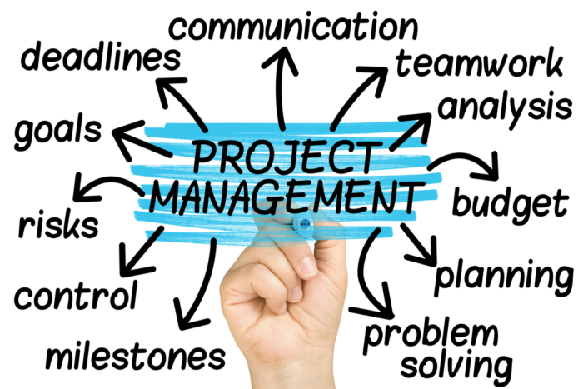
Project management is all about…

Slide 4






AGENDA
Who are the people involved in a project?
PROJECT LIFECYCLE
Why don’t the customer and developer think the same way?
What is a sprint?
What is a user story?
How do we break down a user story to sub tasks?
TEAM WORK
How do we work in a team?

Slide 5


AGENDA
Who are the people involved in a project?
PROJECT LIFECYCLE
Why don’t the customer and developer think the same way?
What is a sprint?
What is a user story?
How do we break down a user story to sub tasks?
TEAM WORK
How do we work in a team?

Slide 6
ACTIVITY
10 MIN
Who are the people involved in a web app project?
OUTSIDE THE COMPANY
INSIDE COMPANY

Slide 7



EXPLAIN
05 MIN
Who are the people involved in a web app project?
OUTSIDE THE COMPANY
INSIDE COMPANY
User
Customer
Project
Manager
Developers
Uses the project
Buys the project
Builds the project

Slide 8
AGENDA
Who are the people involved in a project?
PROJECT LIFECYCLE
Why don’t the customer and developer think the same way?
What is a sprint?
What is a user story?
How do we break down a user story to sub tasks?
TEAM WORK
How do we work in a team?

Slide 9
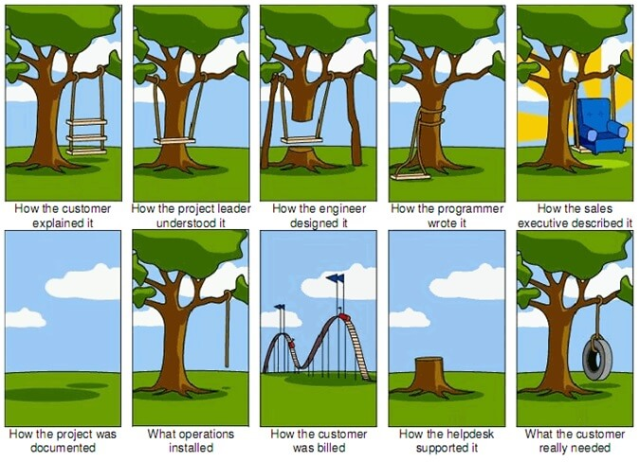
EXPLAIN
It’s hard to understand exactly the customer

Slide 10
WEATHER APP
What the IT team has created :
Cambodia Phnom Penh
15/01/2023 28 degree
REMOVE
France Paris
15/02/2023 05 degree
REMOVE
Cambodia Phnom Penh
16/01/2023 31degree
REMOVE
+
Cambodia Phnom Penh
17/02/2023 29 degree
REMOVE

Slide 11
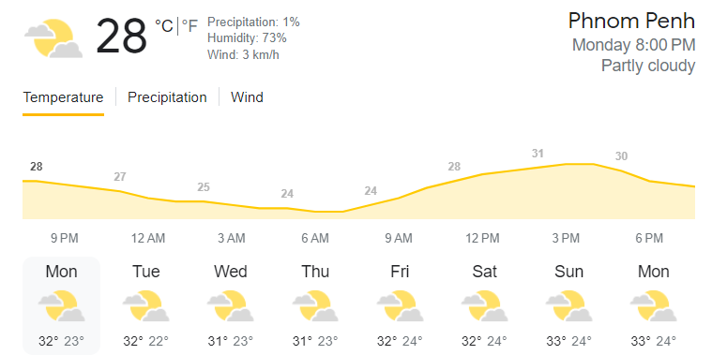
WEATHER APP
What the customer wanted :

Slide 12
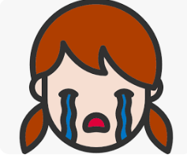
ACTIVITY
10 MIN
What do you suggest to avoid customer disappointments?
Before coding
During coding
After coding

Slide 13
EXPLAIN
What do you suggest to avoid customer disappointments?
Before coding
During coding
After coding
Analyze the need
Validate design
Ask user to test
Design something

Slide 14




EXPLAIN
We need a process!!!
ANALYSE
DESIGN
PLAN
DEVELOP
TEST

Slide 15
AGENDA
Who are the people involved in a project?
PROJECT LIFECYCLE
Why don’t the customer and developer think the same way?
What is a sprint?
What is a user story?
How do we break down a user story to sub tasks?
TEAM WORK
How do we work in a team?

Slide 16
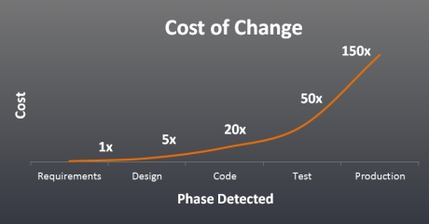
The more you wait, the more it costs

Slide 17
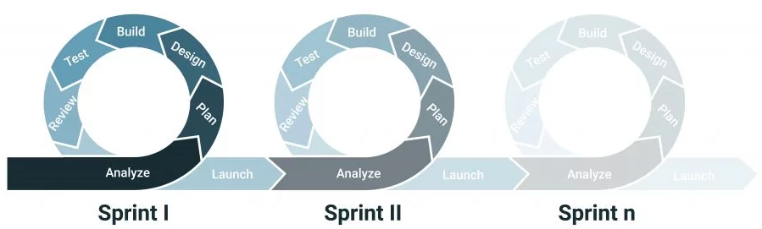



EXPLAIN
A sprint is a short time (a few weeks) with an objective for the team to produce a clear result

Slide 18

EXPLAIN
A sprint is composed of a list of features to bring to the application (the user stories) and bugs to fix
SPRINT 1
USER STORY
BUG
USER STORY
USER STORY

Slide 19
AGENDA
Who are the people involved in a project?
PROJECT LIFECYCLE
Why don’t the customer and developer think the same way?
What is a sprint?
What is a user story?
How do we break down a user story to sub tasks?
TEAM WORK
How do we work in a team?

Slide 20
EXPLAIN
User stories are short descriptions of an application feature from the perspective of a user
As a Shop owner, I want to locate an item in the shop so that I can pick it up
+
+
WHO
WHAT
WHY

Slide 21
EXPLAIN
A user story is a need from a person involved in the application
I need to know notify Social affair if I m sick
I need to make sure the code of the application is maintainable
I need to check student attendance
Social
Affair
Student
Project
Manager
Developers

Slide 22
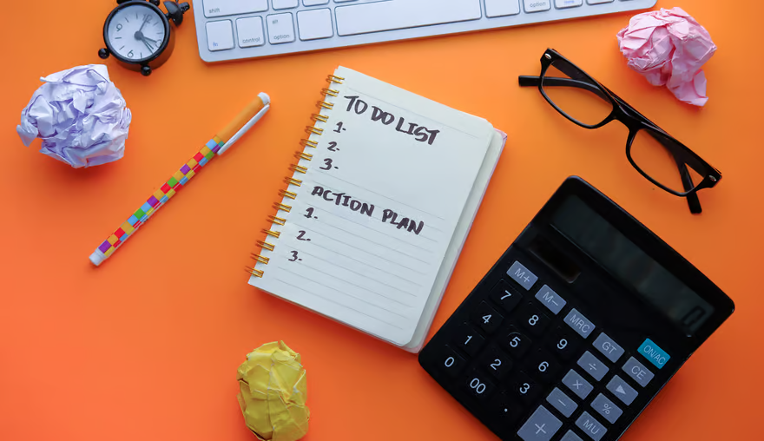
HOW TO BREAK DOWN A USER STORY INTO SUB TASKS?

Slide 23

ACTIVITY
As PNC students, we want to organize a party for Khmer New Year
15 MIN
In teams, break down this user story into sub tasks
Use post it
Find sub tasks for each categories :
When tasks can be done in parallel, put then in different columns :
Create a poster to communicate on this event
Rent a music system
Those tasks need to be done in order
Identify schools who could participate
Those tasks can be done in parallel (at the same time)
Send the poster to the schools

Slide 24
CORRECTION
As PNC students, we want to organize a party for Khmer New Year
Create a poster to communicate on this event
Prepare the planning of activities
Decide the party meal and drink
Identify schools who could participate
Train activities manager
Buy material the food/drinks
Send the poster to the schools
Buy material for the activities
Find the place for the party
Book the place
Visit the place to check the space

Slide 25
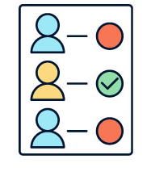

EXPLAIN
What Is sub tasking?
Sub tasking is the process of creating tasks to work in team and estimate the duration of the team work
Easy to estimate
Easy to assign
Essay to follow

Slide 26
ACTIVITY
As user, I want to login to the application
15 MIN
In teams, break down this user story into sub tasks
Use post-it
Find sub tasks for each categories:
MOCK UP
SPECIFICATIONS
HTML, JS, CONTROLER
DATABASE, MODEL
ANALYSE
DESIGN
FRONT END
BACK END
TEST
Understand how the user want to login
If login is correct go to home
If not display error

Slide 27
CORRECTION
As user, I want to login to the application
ANALYSE
Understand how to login
DESIGN
Design the login view
FRONT END
Create the login view and controller
BACK END
Update the database with new table and the model
TEST
Test login

Slide 28
ACTIVITY
As customer, I want the website to be secure and avoid anyone to hack it
15 MIN
In teams, break down this user story into sub tasks
Use post-it
Find sub tasks for each categories:

Slide 29
CORRECTION
As customer, I want the website to be secure and avoid anyone to hack it
RESEARCH
Research about cybersecurity
BACK
Protect from SQL injection
DATABASE
Make sure passwords are encrypted
?
Other security item…

Slide 30
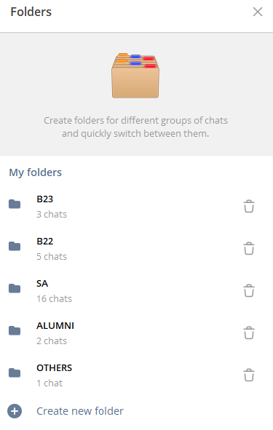
ACTIVITY
60 MIN
As user, I want to manage telegram folders to put my channels
In teams, break down this user story into sub tasks
Use post it
Find sub tasks for each categories :

